Slide 1
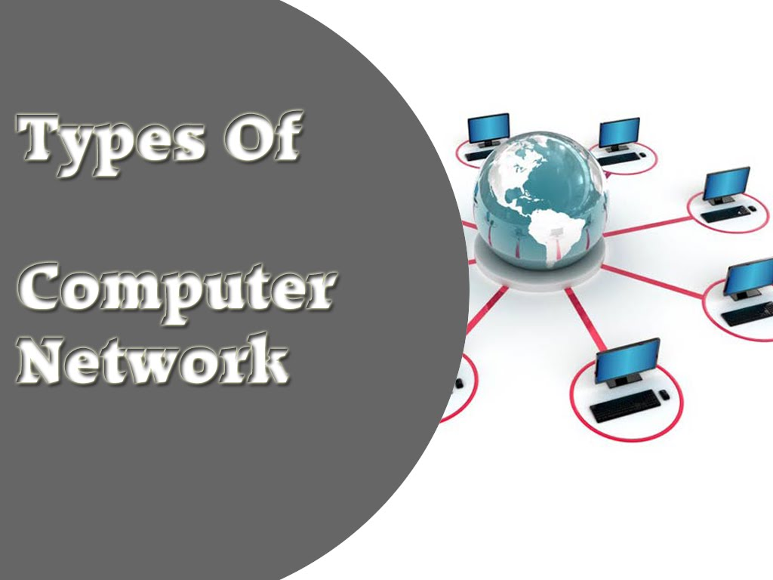
LAN
WAN
MAN
SAN
CAN
PAN
DAN

Slide 2
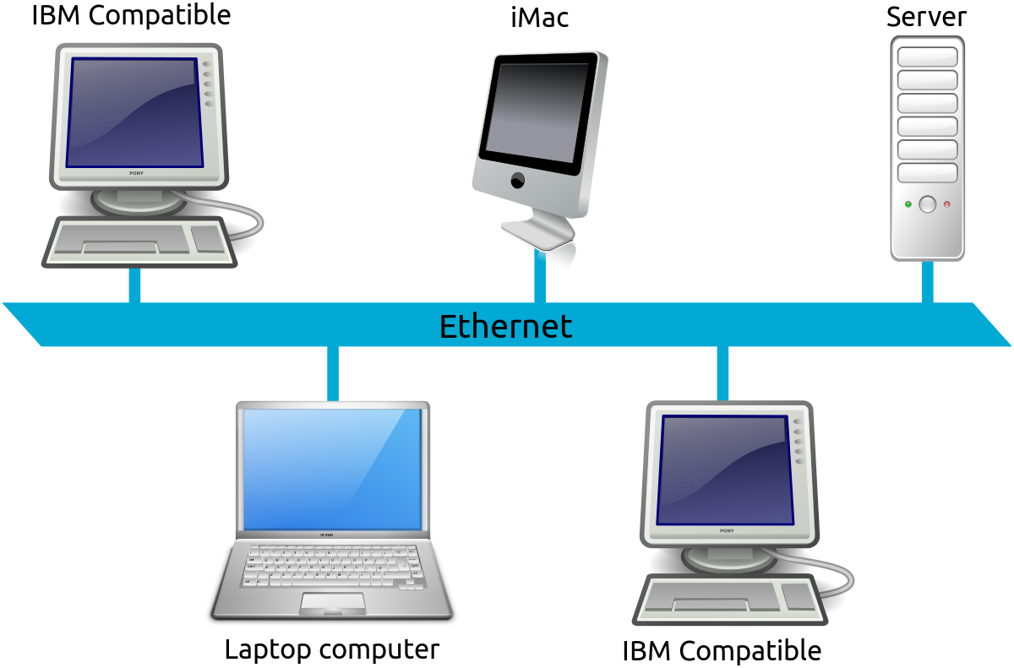
Local Area Network
A group of networks that share a common communication line or wireless link.
Connectivity is only for smaller area.

Slide 3
WIDE AREA NETWORK

Slide 4
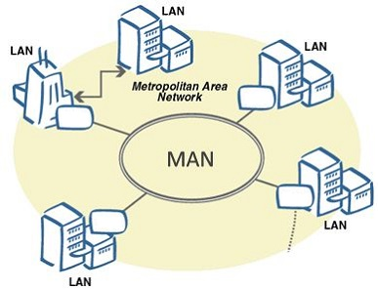
Metropolitan Area Network
Used to mean the interconnection of several local area networks by bridging them with backbone lines.

Slide 5
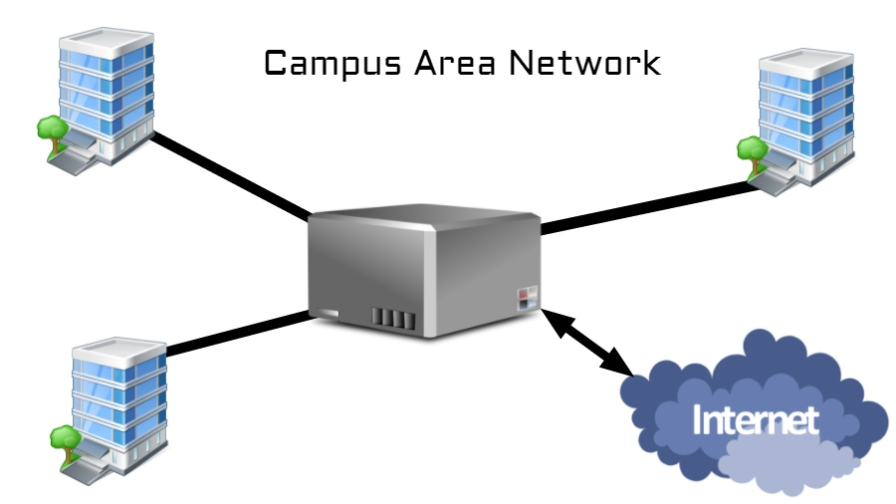
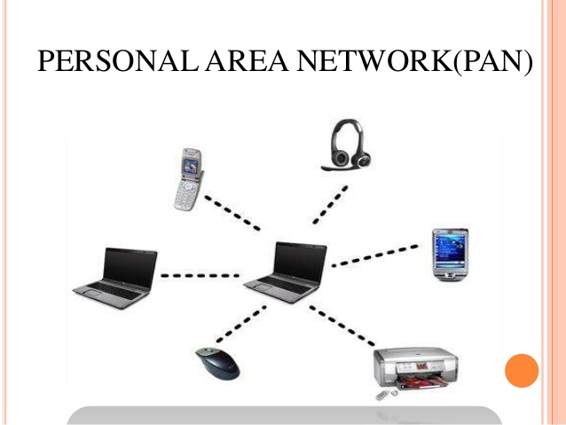

Slide 6
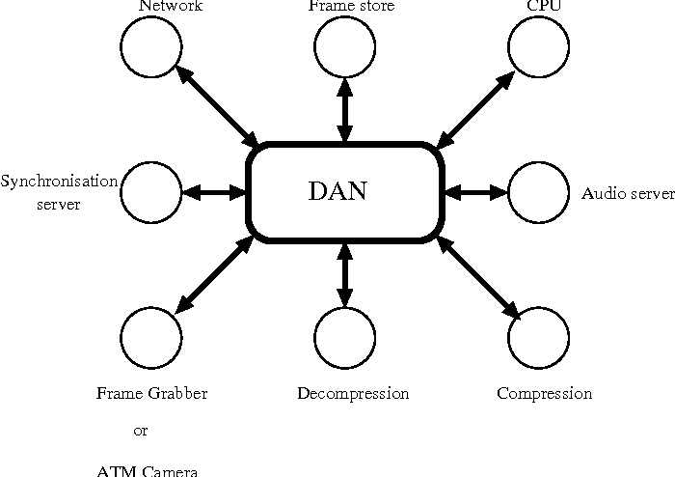
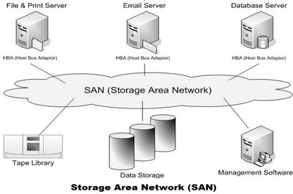

Slide 7

Types
Physical
Logical

Slide 8
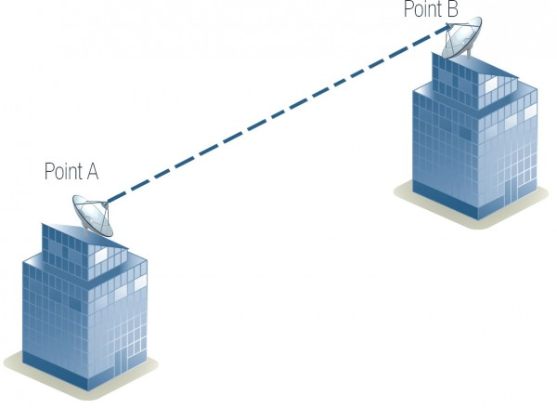
Physical Topology
Defines how the nodes of network is physically connected.
Types
Point-to-point
Simplest of all.
Two categories
Permanent Topology
Switched Topology

Slide 9
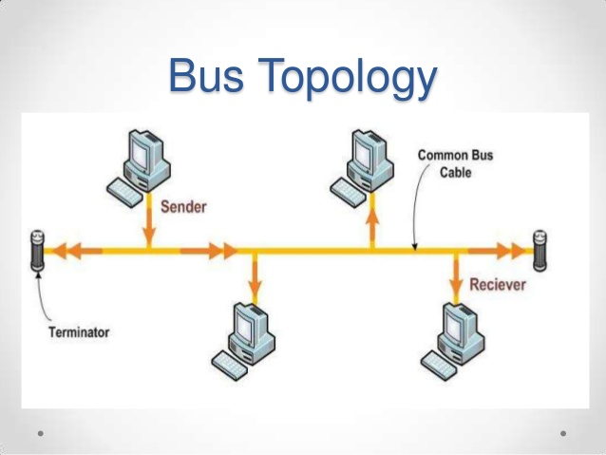
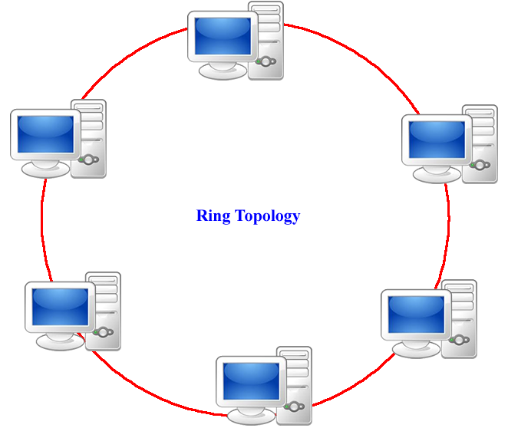

Slide 10
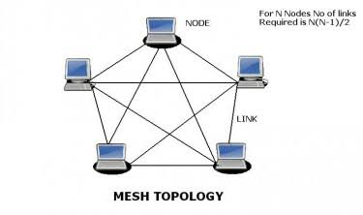
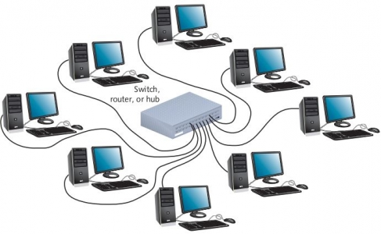
top
Star Topology

Slide 11
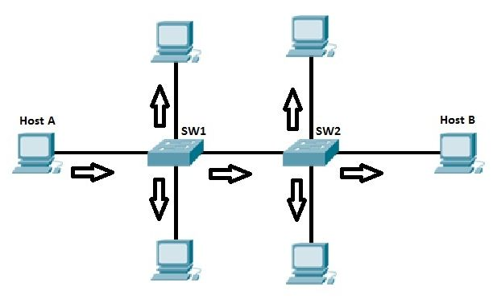
Logical Topology
Defines how the data is transmitted between the nodes.
Types
Broadcast topology
A method of transferring a message to all recipients simultaneously.
All-to-All communication.

Slide 12
Token Passing
A channel access method where a signal called a token is passed between nodes to authorize that node to communicate.
A token is a 24-bit packet that circulates throughout the network from NIC to NIC in an orderly fashion.

Slide 13
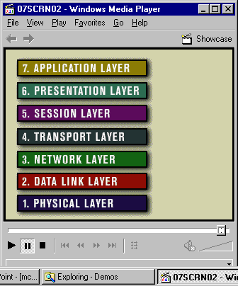
Layer of Models
TCP/IP 4-layers
OSI 7-layers
Application
Transport
Network
Network Interface

Slide 14
OSI Models
Open Systems Interconnection (OSI) is a set of internationally recognized, non-proprietary standards for networking and for operating system involved in networking functions.
Layers
7. Application Layer
6. Presentation Layer
5. Session Layer
4. Transport Layer
3. Network Layer
2. Data Link Layer
1. Physical Layer

Slide 15
LAYER 7 – The APPLICATION Layer
The top layer of the OSI model.
Provides a set of interfaces for sending and receiving applications and to use network services, such as: message handling and database query processing.
Responsibility: Providing services to the user.

Slide 16
LAYER 6 – The PRESENTATION Layer
Manages data-format information for networked communications (the network’s translator).
For outgoing messages, it converts data into a generic format for network transmission; for incoming messages, it converts data from the generic network format to a format.
Responsible: for certain protocol conversions, data encryption/decryption, or data compression/decompression.
A special software facility called a “redirector” operates at this layer to determine if a request is network related on not and forward network-related requests to an appropriate network resource

Slide 17
LAYER 5 – The SESSION Layer
Enables two networked resources to hold ongoing communications (called a session) across a network.
Applications on either end of the session are able to ex hange data for the duration of the session.
Responsible:
For initiating, maintaining and terminating sessions.
For security and access control to session information (via session participant identification).
For synchronization services, and for checkpoint services

Slide 18
LAYER 4 – The TRANSPORT Layer
Manages the transmission of data across a network.
Provides acknowledgements of successful transmissions and requests resends for packets which arrive with errors.
Responsible for the delivery of a message from one process to another.

Slide 19
LAYER 3 – The NETWORK Layer
Handles addressing messages for delivery, as well as translating logical network addresses and names into their physical counterparts.
Responsible for deciding how to route transmissions between computers.
Handles the decisions needed to get data from one point to the next point along a network path.

Slide 20
LAYER 2 – The DATA LINK Layer
Handles special data frames (packets) between the Network layer and the Physical layer.
At the receiving end, this layer packages raw data from the physical layer into data frames for delivery to the Network layer.
At the sending end this layer handles conversion of data into raw formats that can be handled by the Physical Layer.

Slide 21
LAYER 1 – The PHYSICAL Layer
The bottom layer of the OSI model.
Manages the interface between the the computer and the network medium.
This layer tells the driver software for the MAU what needs to be sent across the medium.
For outgoing messages: Converts bits into electronic signals.
For incoming messages: Converts electronic signals into bits.
Responsible: For movements of individual bits from one hop (node) to the next.

Slide 22
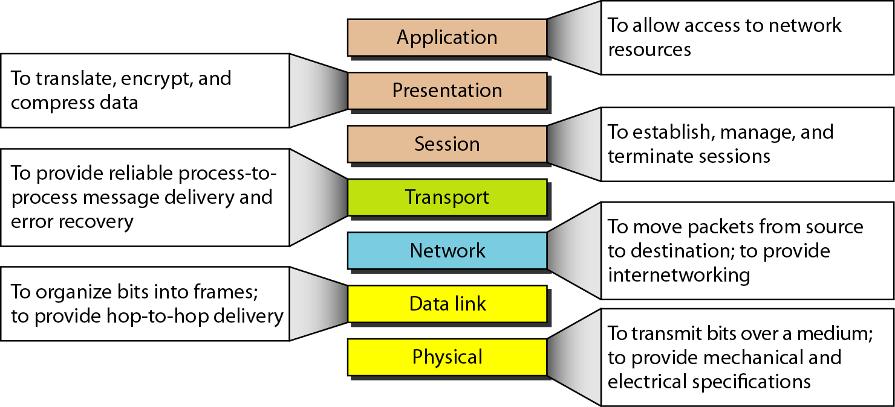
Summary

Slide 23
TCP/IP
Transmission Control Protocol/Internet Protocol.
It is the language a computer uses to access the internet. It consists of a suite of protocols designed to establish a network of networks to provide a host with access to the internet.
Layers
1. Application Layer
2. Transport Layer
3. Network Layer
4. Data link & Physical Layer.

Slide 24
Layer-1 Application Layer
Defines the rules when implementing specific network applications.
Rely on the underlying layers to provide accurate and efficient data delivery.
Typical protocols:
FTP – File Transfer Protocol
For file transfer
Telnet – Remote terminal protocol
For remote login on any other computer on the network
SMTP – Simple Mail Transfer Protocol
For mail transfer
HTTP – Hypertext Transfer Protocol
For Web browsing

Slide 25
Layer-2 Transport Layer
Application
Transport
Network
Network Interface
Message
Segments
h
M
h
M
h
M

Slide 26
Layer-3 Network Layer
Application
Transport
Network
Network Interface
Message
Segments
h
M
h
M
h
M
h
h
M
h
h
M
h
h
M
Datagrams / Packets

Slide 27
Layer-4 Data Link and Physical Layers
Application
Transport
Network
Network Interface
Message
Segments
h
M
h
M
h
M
h
h
M
h
h
M
h
h
M
Packets
h
h
h
M
h
h
h
M
Frames

